Slide 1

King County
Houses Sales Data
This Photo by Unknown Author is licensed under CC BY-SA

Slide 2

Contents
01
Overview
04
Regression Results
02
Business and Data Understanding
05
Conclusion
03
Modelling
06
Thank you
This Photo by Unknown Author is licensed under CC BY-NC-ND

Slide 3
King County
With nearly 2.2 million residents, King County is the largest county in Washington State. Nationally, it is the 13th largest by population and ninth-largest by total employment. Two million of its residents live in one of the 39 cities in the county and the remaining 200,000 in the unincorporated area. Seattle, the largest city in the county, is home to 730,000 residents
It is home to Seattle, the state's largest city, and is a hub of innovation, technology, and creative industries. The housing market in King County has been one of the fastest-growing in the country, with strong demand and limited supply leading to a highly competitive market
O
This Photo by Unknown Author is licensed under CC BY-NC-ND

Slide 4
BUSINESS UNDERSTANDING
In response to demand for housing by high-earner households, new developers are planning to build new housing facilities.The agency is trying to figure out the attributes in homes that will have the greatest effects hence bring the greatest returns when selling the houses
Ax
This Photo by Unknown Author is licensed under CC BY-NC-ND

Slide 5
Data Understanding
Types of Data Used
The two main types of data used was numerical data and categorical data. Numerical data was Date, Price, bathrooms, bedrooms, Living space size, Lot size, Floors, House Size, Basement size, Year renovated, Latitude & longitude. The categorical data used was Id, View, Condition, Grade and Zipcode
This Photo by Unknown Author is licensed under CC BY-NC-ND

Slide 6
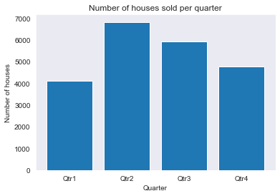
Sale of houses per Quarter
People in the King County region bought houses more in the second quarter of the year
This Photo by Unknown Author is licensed under CC BY-NC-ND

Slide 7
Exploratory Data Analysis
Price
USD 1120000
$USD 78,000
$471531
Maximum Price
Minimum Price
Average Price
From our analysis this was the maximum price of the houses in King County.
From our analysis this was the minimum price of the houses in King County.
From our analysis this was the average price of the houses in King County.
This Photo by Unknown Author is licensed under CC BY-NC-ND

Slide 8
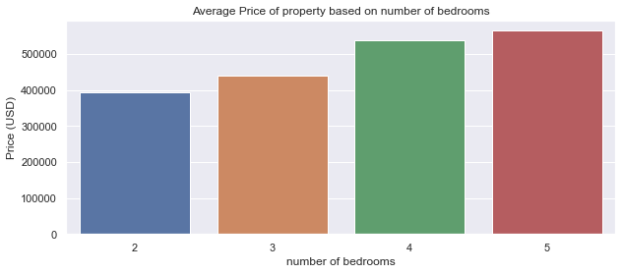
Bedrooms
4
The prices of houses increase as the number of bedrooms increase.

Slide 9
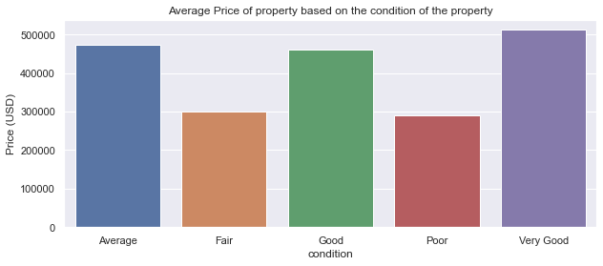
Condition
The prices that have been kept in good conditions are highly priced..
This Photo by Unknown Author is licensed under CC BY-NC-ND

Slide 10
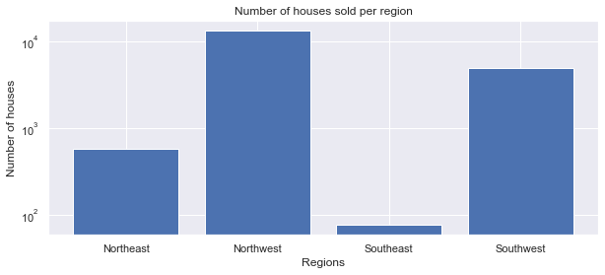
Region
4
The leading region in terms of the number of houses sold was the North West region while the South East region was trailing.

Slide 11
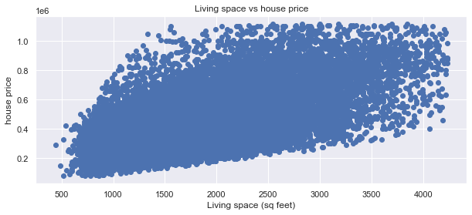
MODELLING
Simple Linear Regression
We created a model to predict price using Sqft_living as the independent variable and price as the dependent
Multiple Linear Regression
We created a model to predict price using bedrooms + bathrooms + sqft_living + sqft_lot + waterfront +floors +year +conditioning
This Photo by Unknown Author is licensed under CC BY-NC-ND

Slide 12
Regression Results
Price vs Sqft_Living
The r-squared value, 0.363, shows that the model can account for about 36.3% of the variability of price around its mean. All of the p-values round to 0.. An increase of 1 sq foot in sqft_living will result in an increase in house price by USD 122100
Multiple Linear Regression
The r-squared value, 0.608, shows that the model can account for about 60.8% of the variability of price around its mean with all the p values around 0 which implies that a null hypothesis developed can be rejected
This Photo by Unknown Author is licensed under CC BY-NC-ND

Slide 13
Conclusion
The multiple linear regression model is better than the two simple regression models as it had a higher R-squared value. This shows that categorical variables had a positive effect on the prices as illustrated in the univariate analysis.
The real estate agent should review the sqft of the living space when setting their house prices as there is a linear relationship between the variables.
Factors such as bathrooms, bedrooms, waterfront, view, condition , should be looked into as they have a positive effect on the house price
This Photo by Unknown Author is licensed under CC BY-NC-ND

Slide 14

Thank you!
Feel free to reach out to us if you have any questions.

